Slide 1




Evaluations and Trials in Alma
Yoel Kortick. Senior Librarian
https://www.askideas.com/20-amazing-sunset-view-pictures-and-images-of-charles-bridge/

Slide 2
New features in this presentation
Add participants to a trial from a set of users
Multiple choice questions of type single answer
Multiple choice questions of type multiple answer
New sections and layout of the survey form
A new “Survey form prefix”
A new “comments” field for specific questions
Drag and drop to reorder questions
“Reset Notification” for users who did not receive a letter
“Hide portfolio” and “hide collection” tab.
Link from POL to trial
Tab with number of participants and number notified.

Slide 3

Contents
Introduction
Creating the evaluation process
The survey questions
Trial activation and participant notification
Analyzing the trial results

Slide 4
Introduction
This presentation will point out new features recently added to the Trials and Evaluations functionality. This will be done within the framework of the creation and running of a trial.
For a general overview of working with trials see:
https://knowledge.exlibrisgroup.com/Alma/Product_Documentation/010Alma_Online_Help_(English)/020Acquisitions/060Evaluations_and_Trials

Slide 5
Introduction
Running a trial in order to evaluate an electronic resource, or collection of resources, is typically done in one of the following two cases:
A vendor offers new electronic material to the institution for evaluation
A request is received from a member of the institution to have electronic material evaluated
The evaluation is the workflow of using and evaluating the material.
A trial is an instance of the evaluation workflow.

Slide 6
Introduction
In Alma the evaluation is done via a well defined workflow.
The workflow of the evaluation determines the way in which a PO line evaluation is handled.
The evaluation starts at the time the POL is created and ends when a decision is made whether to purchase the electronic material.
For a diagram of the process see here.

Slide 7
Introduction
The steps in the process are:
Trial operator / manager receives offer from vendor or member of the institution
Purchase operator creates a POL for the trial
Trial operator / manager creates a survey form and enters trial details.
The POLs may be evaluated
The trial participant is invited to participate in the survey, he completes and submits the survey form
The trial operator / manager reviews the results of the survey forms and makes a purchasing decision
One of the following occurs:
  A decision is made to purchase and the standard purchasing workflow continues
  A decision is made not to purchase and the POL is canceled.

Slide 8
Contents
Introduction
Creating the evaluation process
The survey questions
Trial activation and participant notification
Analyzing the trial results

Slide 9
Creating the evaluation process
We will begin the demonstration by creating a new trial.
This can be done as follows
Make POL for purchase type of one of the following:
  Electronic title one time
  Electronic collection one time
  Electronic collection subscription
In the POL choose one of the following (both of which are explained in the following slide)
  Save and request evaluation
  Save and request trial

Slide 10
Creating the evaluation process
From the POL it is possible to do either of the following
  “Save and request evaluation”
    Can be done by the Purchasing Operator without a Trial Operator role.
    The PO line’s status changes to Under Evaluation and moves to the Manage Trials page with the status Requested
  “Save and start trial”
    Can be done by the Purchasing Operator with a Trial Operator role. It will automatically start the trial.
    The PO line’s status changes to Under Evaluation and the Trial Details page open

Slide 11
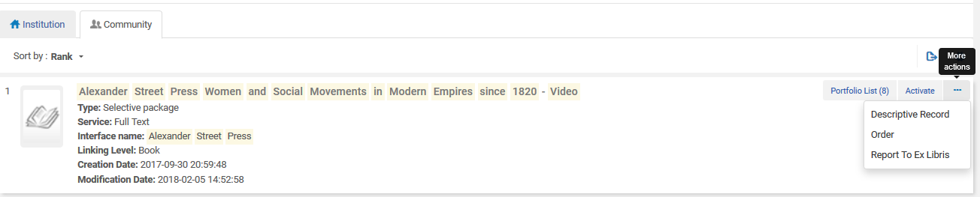
Creating the evaluation process
We will place an order from the Community Zone for electronic collection (with 8 portfolios) “Alexander Street Press Women and Social Movements in Modern Empires since 1820 – Video”

Slide 12
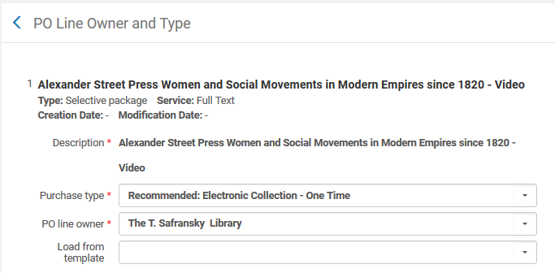
Creating the evaluation process
In this case the order is for “Electronic Collection One Time”

Slide 13
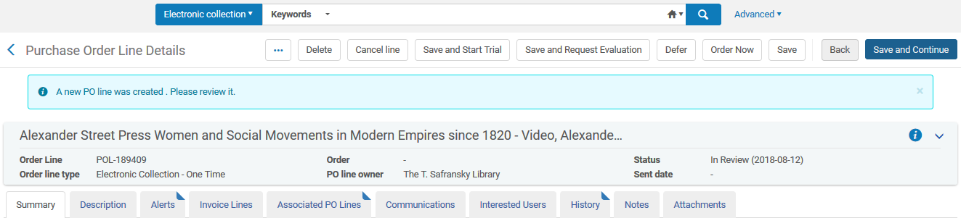
Creating the evaluation process
In the order we will choose “Save and Start Trial”

Slide 14
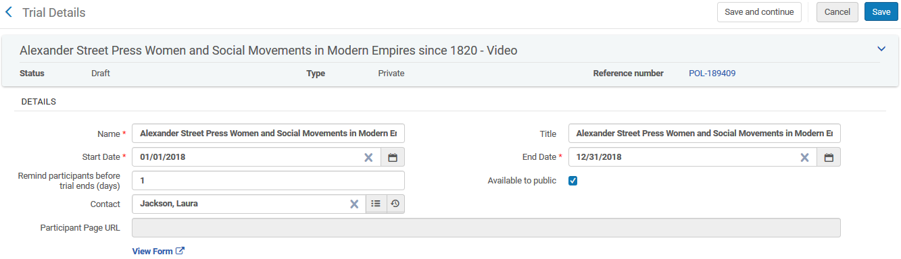
Creating the evaluation process
The “Trial Details” page opens. It can be filled in and saved. Here we will fill in initial details and click “Save”

Slide 15
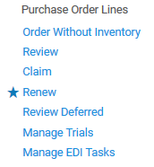
Creating the evaluation process
The trial will then appear on the “Manage Trials” page. It is accessible from the menu “Acquisitions > Purchase Order Lines > Manage Trials”.

Slide 16
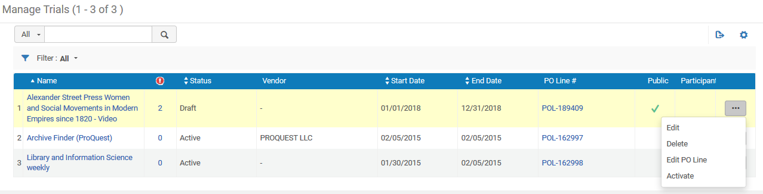
Creating the evaluation process
The list of trials appears
We will click “edit”

Slide 17
Creating the evaluation process
In the “Participants” tab choose the users who will take part in the evaluation.
If the trial is “public” it is not necessary to add participants because a link to the survey can be sent to the participants (as we will later see).
For organization or statistical purposes it may be desired in any case to add participants.

Slide 18
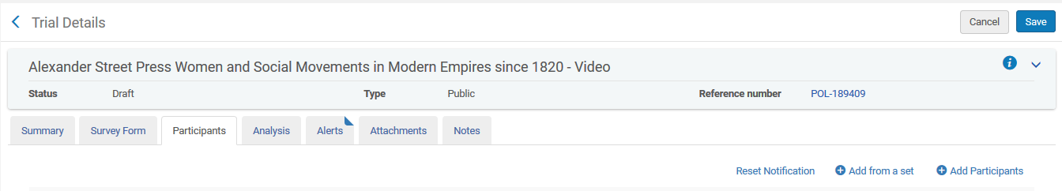
Creating the evaluation process
New in 2018: The ability add participants from a set.
Use “Add from a set” or “Add participants” to add participants

Slide 19
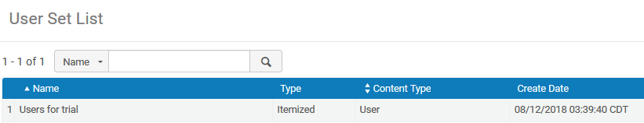
Creating the evaluation process
Here we have clicked “Add from a set” and now we will chose set named “Users for trial”

Slide 20
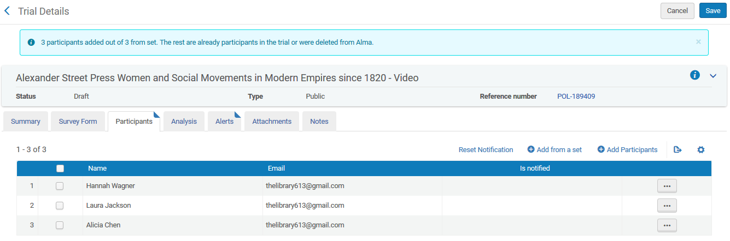
Creating the evaluation process
The participants from the set get added to the trial

Slide 21
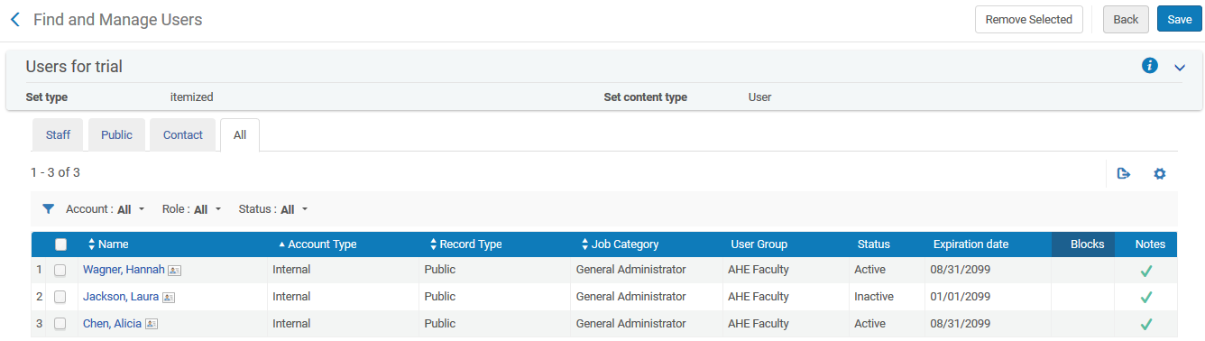
Creating the evaluation process
This is the set of the users who were added.
Note that there are 3 users in this set

Slide 22
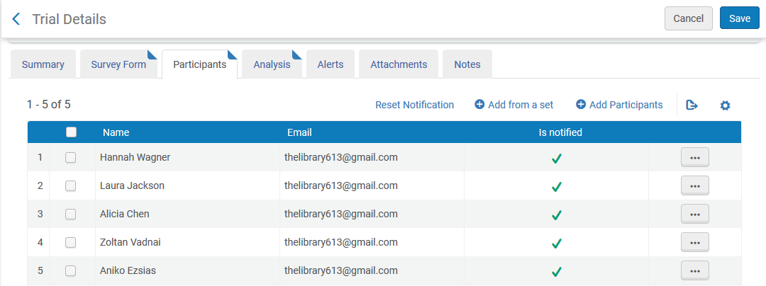
Creating the evaluation process
Additional users (in addition to those in the set) can be added one by one via the “add participants” button. Now we have 5 participants. Three are from a set and two were added manually via the “add participants” button.

Slide 23
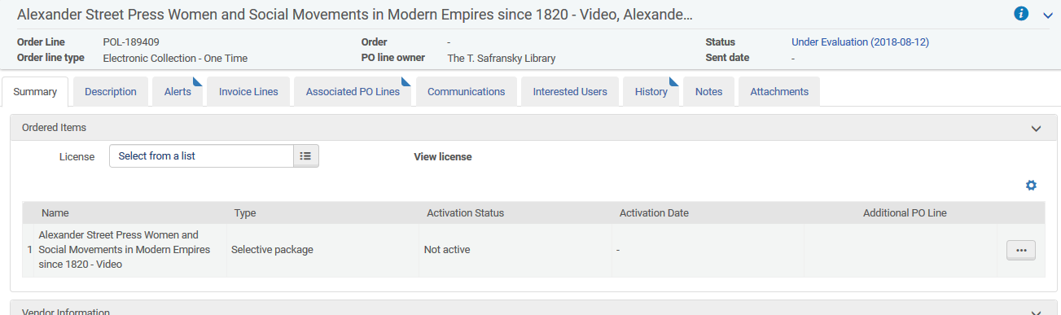
Creating the evaluation process
New for 2018: From the POL which is linked to the Trial it possible to click the status “Under Evaluation” and arrive directly to the Trial.

Slide 24
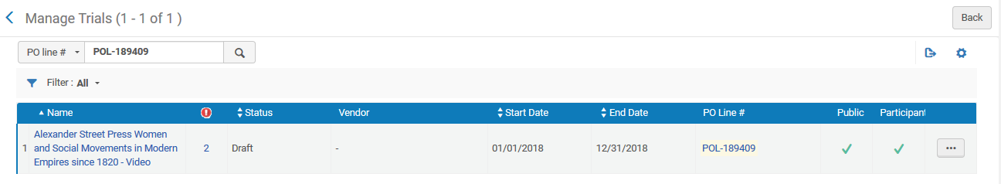
Creating the evaluation process
After clicking “Under Evaluation” we arrive directly to this the trial

Slide 25
Contents
Introduction
Creating the evaluation process
The survey questions
Trial activation and participant notification
Analyzing the trial results

Slide 26
The survey questions
In the “Survey Form” tab choose the questions which will be part of the evaluation.
In 2018 this tab has significantly changed.
Formerly it contained just a “questionnaire” section with two options:
Select questions (to choose from an existing evaluation)
Add question (to add a new question)

Slide 27
The survey questions
New in 2018: the “Survey Form” tab contains three sections:
“Form Configuration” section which includes:
  Checkbox “hide portfolio tab”. If checked there will be no portfolio tab in the survey form.
  Checkbox “hide collection tab”. If checked there will be no collection tab in the survey form.
“General information” section which includes:
  Select questions (to choose from an existing evaluation)
  Add question (to add a new question)
“Questions” section which includes:
  Select questions (to choose from an existing evaluation)
  Add question (to add a new question)

Slide 28
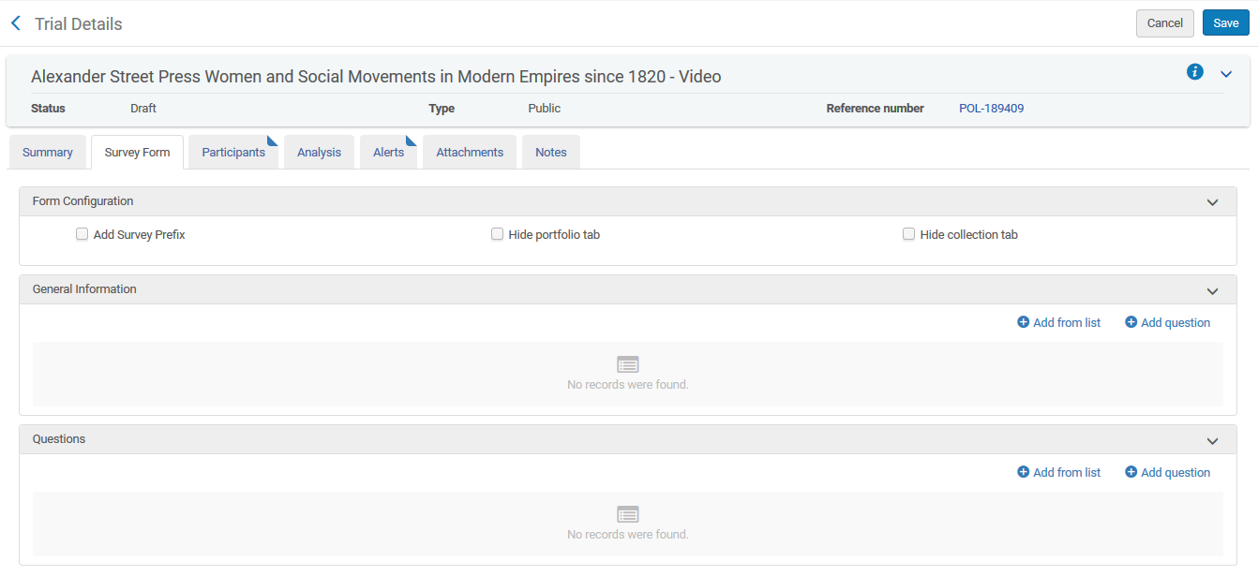
The survey questions
These two sections will appear as separate distinct sections to the end user

Slide 29
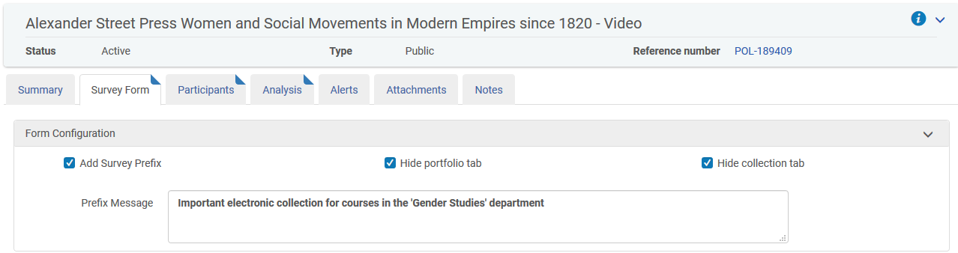
The survey questions
New in 2018: the “Survey Form” contains a “Prefix”

Slide 30
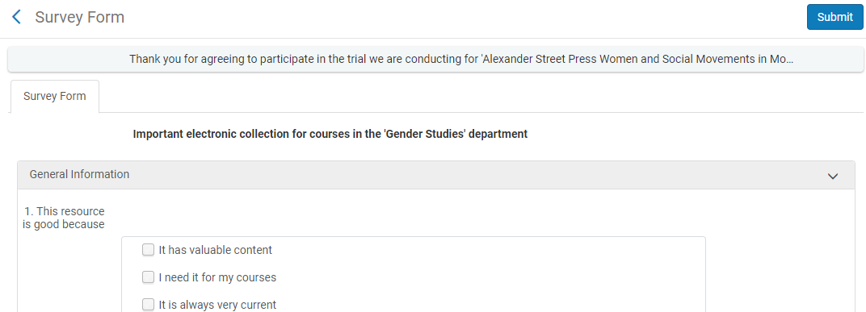
The survey questions
The Survey Form prefix appears to the user at the beginning of the survey

Slide 31
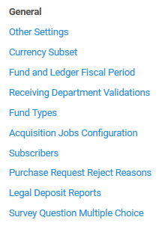
The survey questions
Also new for 2018 is the ability to configure multiple choice questions (via acquisitions configuration menu)
The questions can also be added “on the fly” when adding questions to the trial

Slide 32
The survey questions
The questions can be
Single choice (like a radio button)
  One answer allowed.
  For example “This resource has:” “All of what I need”, “Some of what I need”, “Nothing of what I need”
Multi choice (like check boxes)
  Multiple answers allowed.
  For example “This resource is good because:” "It has valuable content", "I need it for my courses", and "It is always very current"

Slide 33
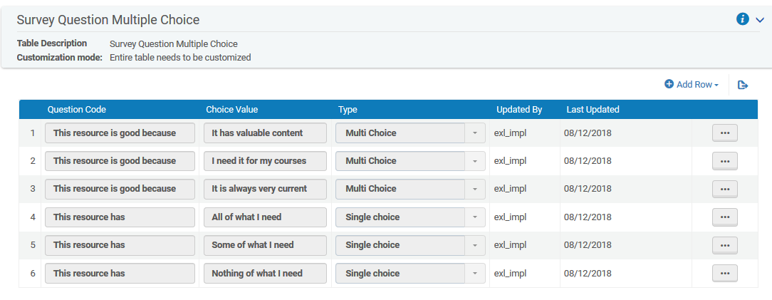
The survey questions
For example
New questions are added here

Slide 34
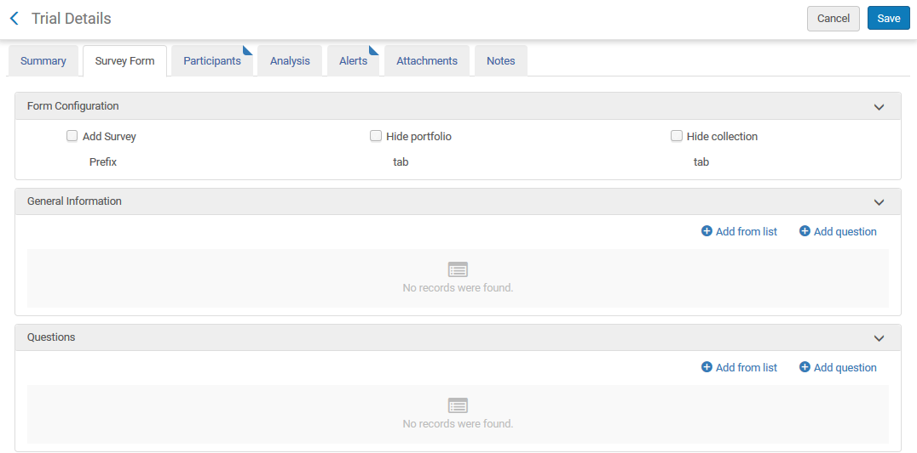
The survey questions
Questions can be added to the survey form via “Add from list” and “Add question”

Slide 35
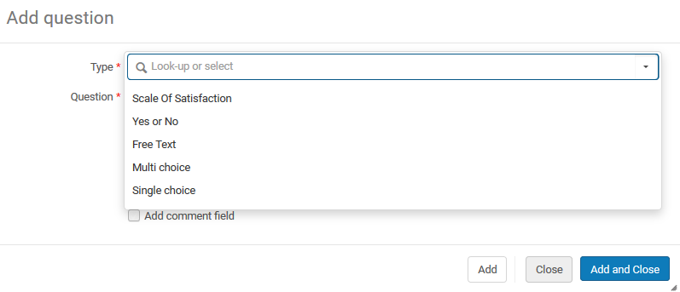
The survey questions
When clicking “Add question” the choices are “Multi choice” and “Single” choice (as seen previously) as well as “Scale of satisfaction”, “Yes or No” and “Free Text”.

Slide 36
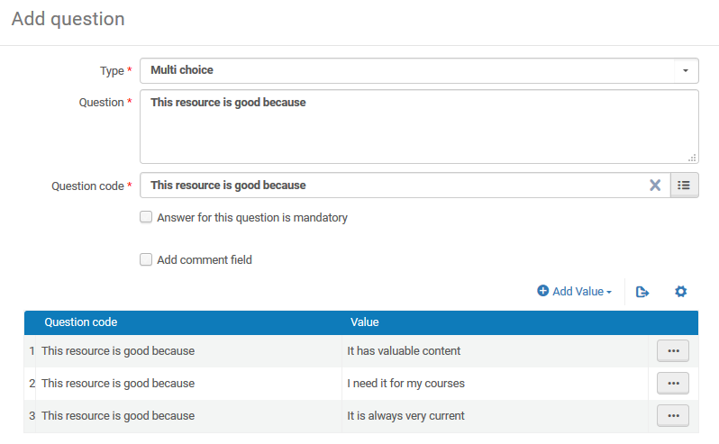
The survey questions
If we choose “Multi choice” then we can fill it in here or search and take from the configuration table we already filled in.
We can also state it is mandatory to answer and add a comment.

Slide 37
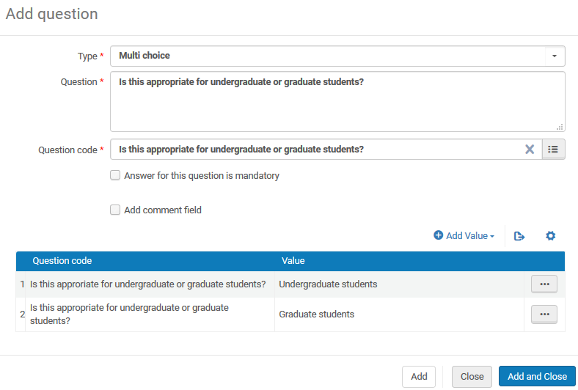
The survey questions
It is possible to add a single or multi choice question here “on the fly” and it automatically gets added to the table of survey form questions we previously edited

Slide 38
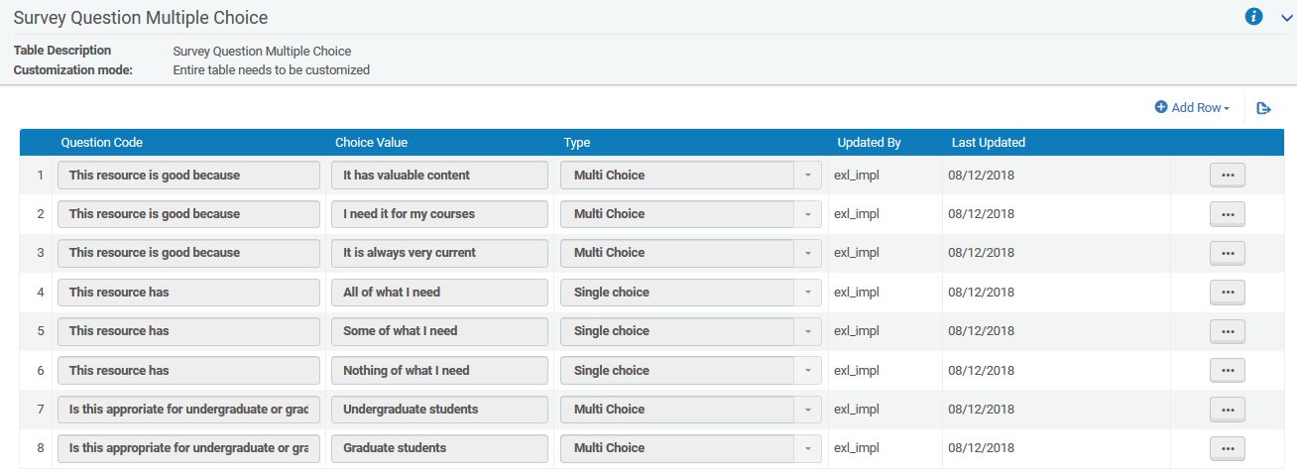
The survey questions
The questions we added from within the form got added here

Slide 39
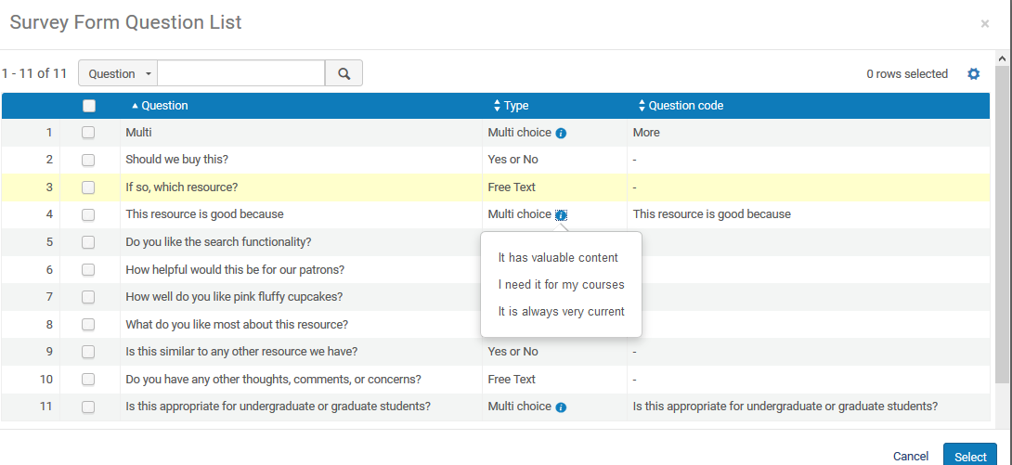
The survey questions
When clicking “Add from list” all previously used questions (in all trials) appear and New for 2018: it is possible to view the possible answers to the questions
View possible answers from the list

Slide 40
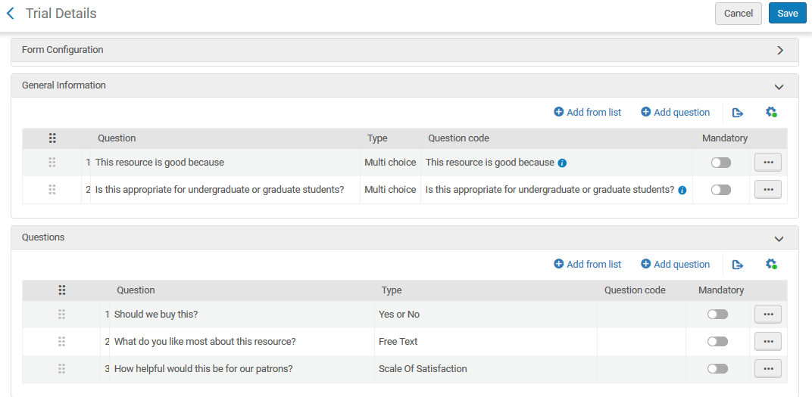
The survey questions
New in 2018: From the “survey form” tab of the trial it is possible to drag and reorder questions (and change to mandatory or optional from the list)
Drag to reorder here
Change to mandatory here

Slide 41
Contents
Introduction
Creating the evaluation process
The survey questions
Trial activation and participant notification
Analyzing the trial results

Slide 42
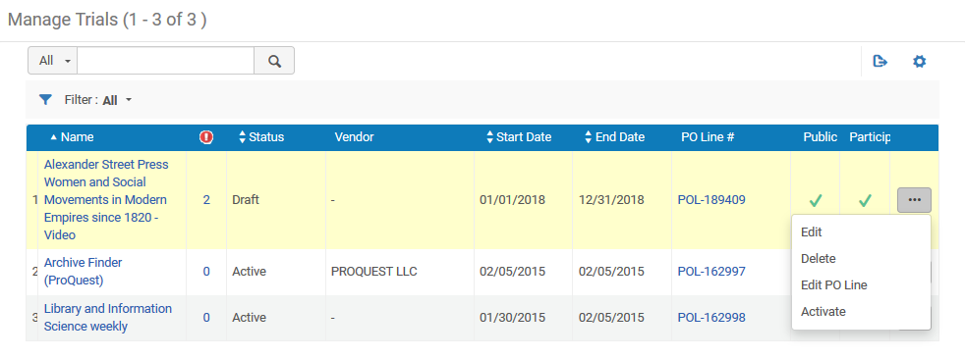
Trial activation and participant notification
We have added questions to the survey form tab and added a set of users to the participants tab.
Now we will activate the resource. Doing ‘Actions > Activate’ from the list of trials activates the resource but not the trial.

Slide 43
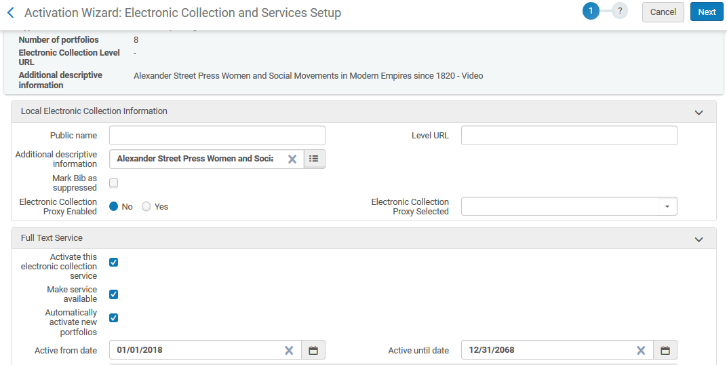
Trial activation and participant notification
After activating we will go through the activation wizard

Slide 44
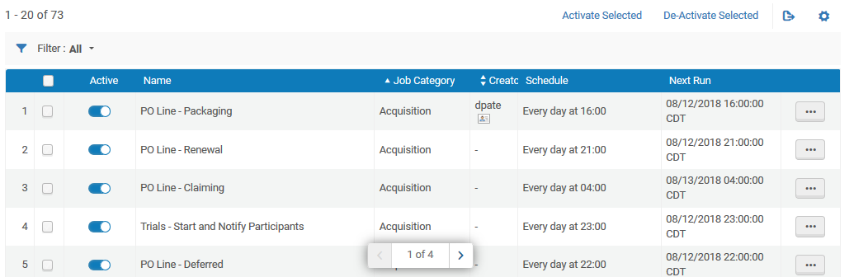
Trial activation and participant notification
The job “Trials – Start and Notify Participants” will activate the trials and send a notification to the participants.
This job activates the trial, not the resource.

Slide 45
Trial activation and participant notification
The job “Trials – Start and Notify Participants” has completed.

Slide 46
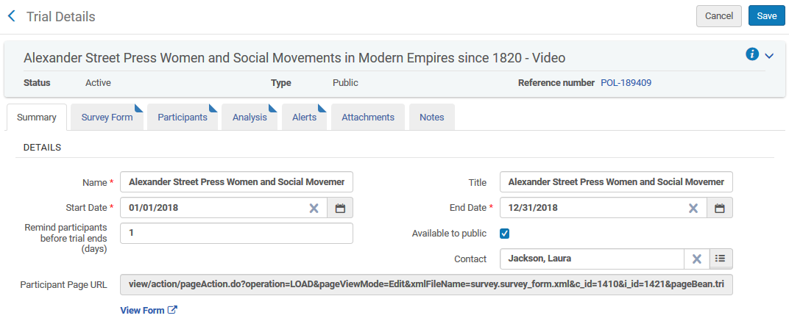
Trial activation and participant notification
New in 2018: In addition to the initial letter, another letter will be sent before the end of the trial according to the field “Remind participants before trial ends (days)”.

Slide 47
Trial activation and participant notification
Participants will get one notification automatically via job " Trials – Start and Notify Participants" (or the "notify participants" action)
Then the participants will get another letter towards the end of the trial.
For example if field “Remind participants before trial ends (days)” is "10" then participants will get another notification 10 days before the trial ends.

Slide 48
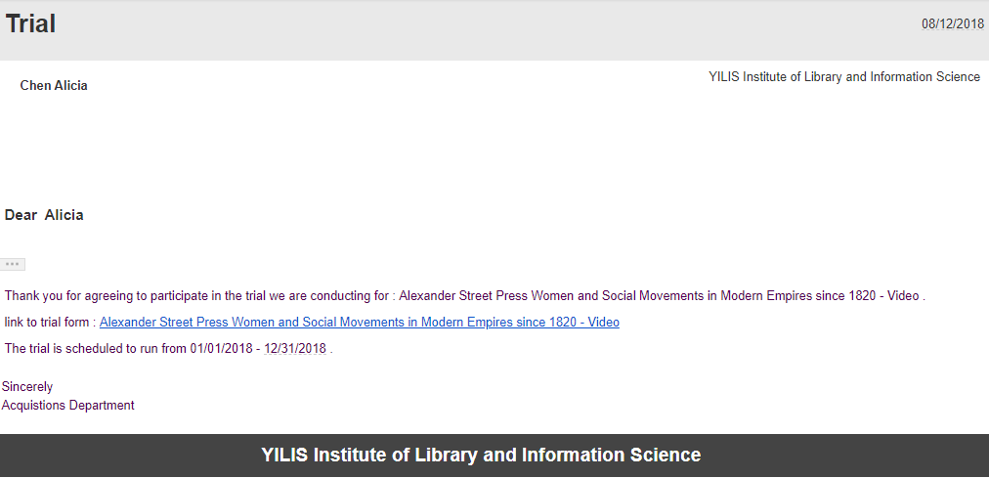
Trial activation and participant notification
Participant Alicia Chen received her letter
From the letter there is a link directly to the survey which the participant can fill in an submit.

Slide 49
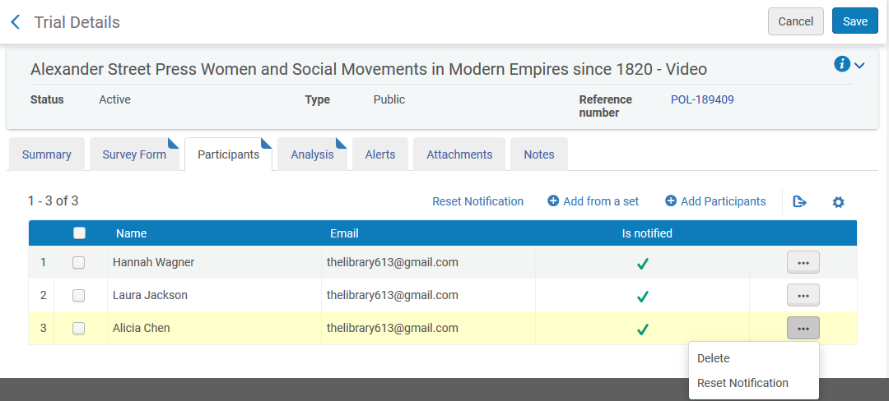
Trial activation and participant notification
New in 2018: If a participant has already been notified but you want to notify him again you can choose “Reset notification”

Slide 50
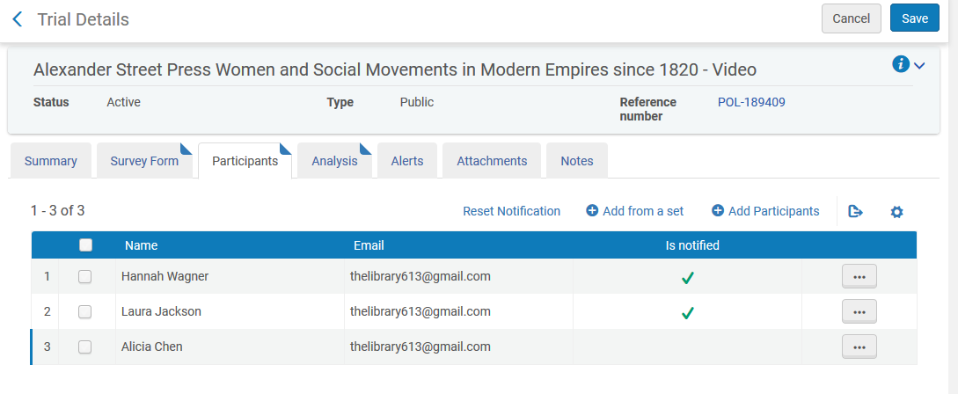
Trial activation and participant notification
The next time participants are notified Alicia will receive a letter and the other participants will not

Slide 51
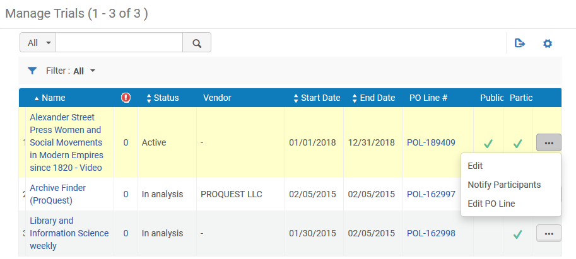
Trial activation and participant notification
It is also possible to send a letter to the trial participants via the “notify” option which appears under the “actions” button for active trials in the Trial List

Slide 52
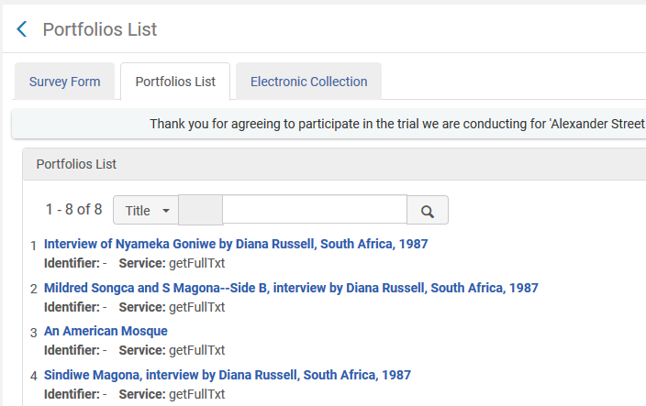
Trial activation and participant notification
The survey contains the portfolio list because we did not hide it

Slide 53
Trial activation and participant notification
New in 2018 is the ability to hide the portfolio tab and collection tab from the survey form

Slide 54
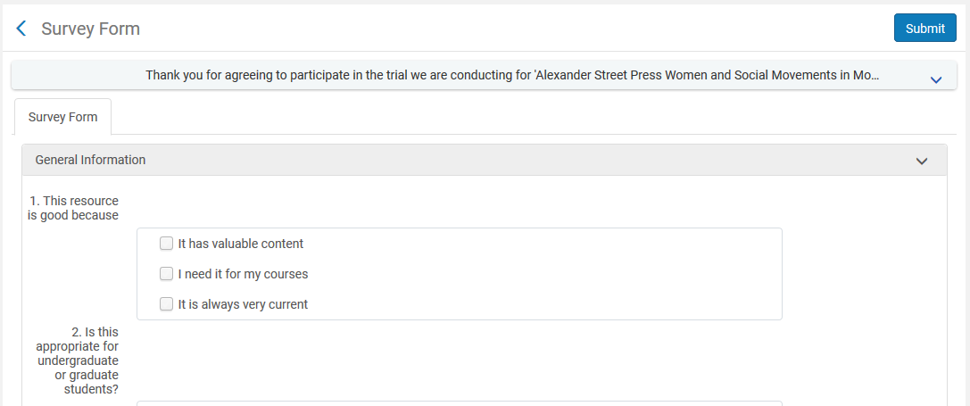
Trial activation and participant notification
Now the portfolio tab and collection tab no longer appear in the survey form

Slide 55
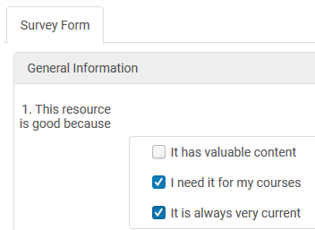
Trial activation and participant notification
For the multiple choice questions participants can choose multiple answers

Slide 56
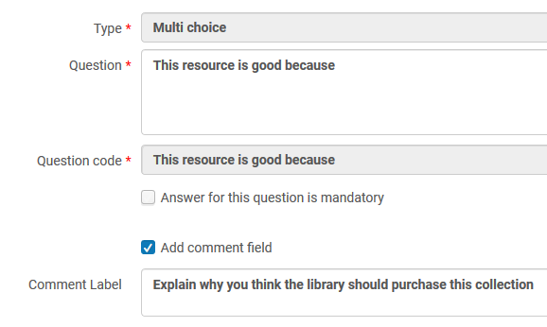
Trial activation and participant notification
Note that it is also possible to add a comment field to questions

Slide 57
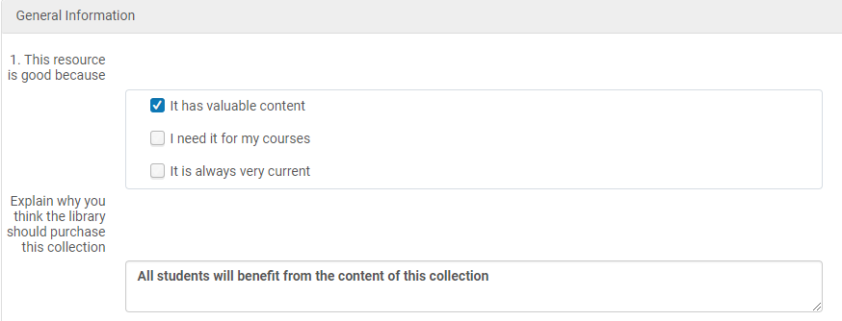
Trial activation and participant notification
The comment field appears and can be filled in as follows to end users

Slide 58
Contents
Introduction
Creating the evaluation process
The survey questions
Trial activation and participant notification
Analyzing the trial results

Slide 59
Analyzing the trial results
When the responses are sent they are automatically recorded in the Analysis tab of the trial.
The Trial Operator can then view the results and on the basis of the responses make a purchasing decision
He can enter the decision in the Analysis and Results section of the Summary tab

Slide 60
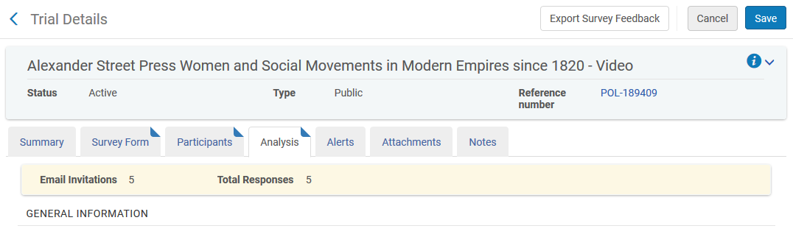
Analyzing the trial results
New in 2018: The “Analysis” tab includes a summary of the number of participants and how many have been notified

Slide 61
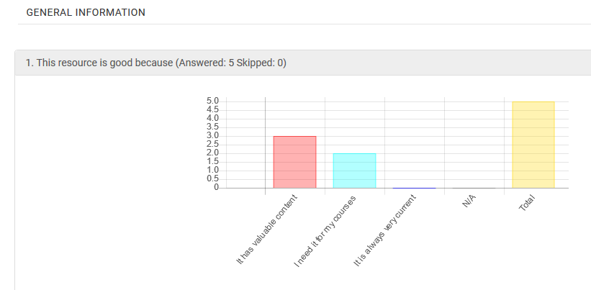
Analyzing the trial results
When the responses are sent they are automatically recorded in the trial.
Here the trial operator views the results, for example:

Slide 62
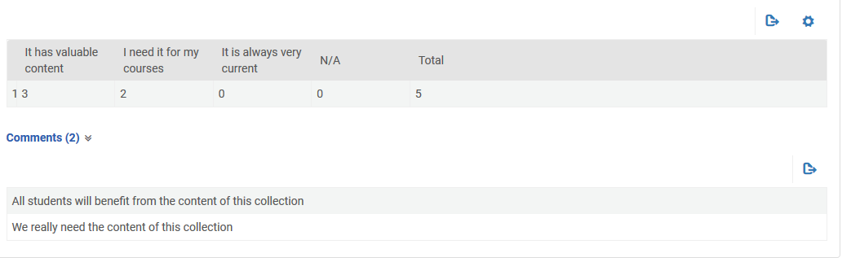
Analyzing the trial results
The comments which then user added in the comments field off a particular question appear as follows in the analysis tab

Slide 63
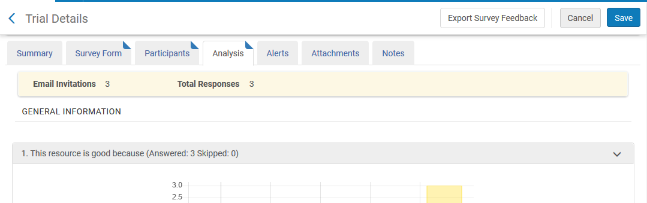
Analyzing the trial results
It is also possible to export the survey feedback

Slide 64
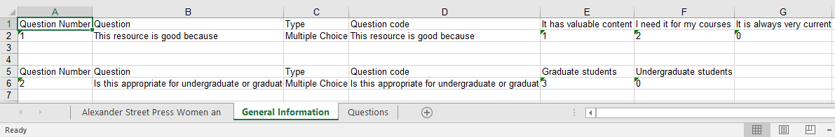
Analyzing the trial results
The feedback is exported to a multi-sheet Excel file

Slide 65
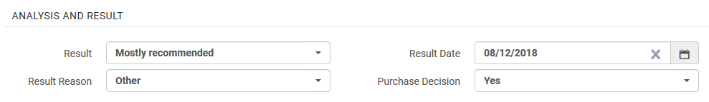
Analyzing the trial results
After viewing the responses and coming to a decision the Trial Operator enters the results and purchasing decision in the Analysis and Results section of the Summary tab.
The minimum information to enter in this section is the Result and Result Date.
This is recorded in the Analysis and Results section of the Summary tab

Slide 66
Analyzing the trial results
After the results are entered, the PO line is saved.
If the decision was made to purchase the material then the Purchasing Operator would typically continue in the normal purchasing workflow.
If the decision was made not to purchase the material, the Purchasing Operator would typically to cancel the PO line

